Slide 1



Impact of Economic Growth and Education in Infant Mortality in the 21st Century
FORTE - RUTA N
DS4 Team #6
October 29th, 2022

Slide 2







Team #6
Carlos Chávez Yohana Sandoval Daniel Durán Eider Giraldo
Fernán Marsiglia Juan Alzate Martha Ordoñez

Slide 3

Agenda
Introduction -
Problem description
Methodology
Results - Dashboard
Conclusions

Slide 4

Problem Overview
We want to identify how education and economic growth have had an impact in infant mortality in the 21st century. This is important because it allows us to know the living conditions at an early age, which gives us the possibility to measure how healthy a region or a country is.
Unit of measurement = Number of deaths per /1.000 live births.
The importance of the mortality variable for the countries as an indicator of health and progress is analyzed.
Notes:
It is important to conduct comprehensive and interdisciplinary analyses that consider as much information as possible.
Such information can be relevant to governmental decision-making on the direction of each country and/or region. This can enable the design and implementation of public policies aligned with the needs of the population and the objectives and goals of sustainable development (Agenda 2030).
Global, regional, and national statistics on population. Also, health and mortality indicators are essential in order to assess development and health progress to guide resource allocation. Specifically, this data is used to monitor progress towards health-related targets within the Sustainable Development Goals (SDGs).

Slide 5
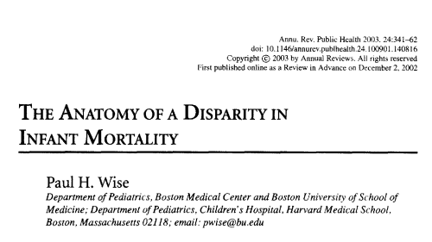

Infant mortality has 6 main causes:
Pneumonia (19%),
Diarrhea (17%),
Premature birth (10%),
Neonatal infections (10%),
Malaria (8%)
Lack of oxygen at birth (8%).
Notes:
Infant mortality is the probability of a newborn dying before reaching one year of age. The measurement of this indicator reflects the health conditions of children in a society and its social determinants.
Approximately 9 million children under the age of 5 die each year, which means that a child dies in the world every 4 seconds.

Slide 6
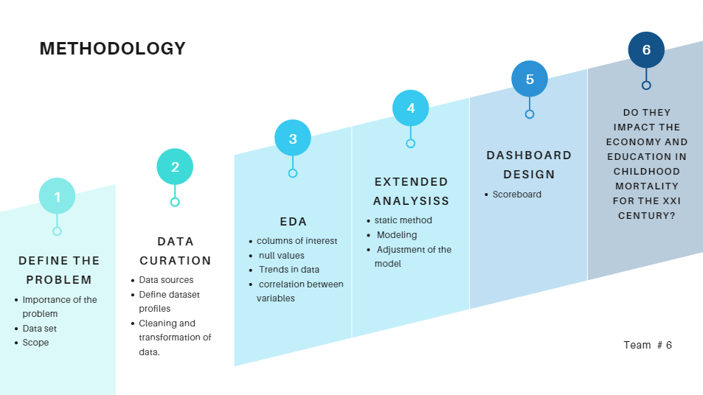

Slide 7

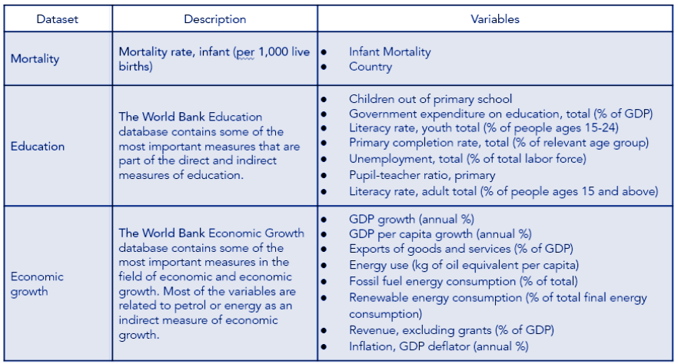
Data
Notes:
We work with datasets given by the World Bank Organization mainly, in addition with FMI datasets. We consider the sources to be reliable and robust.

Slide 8
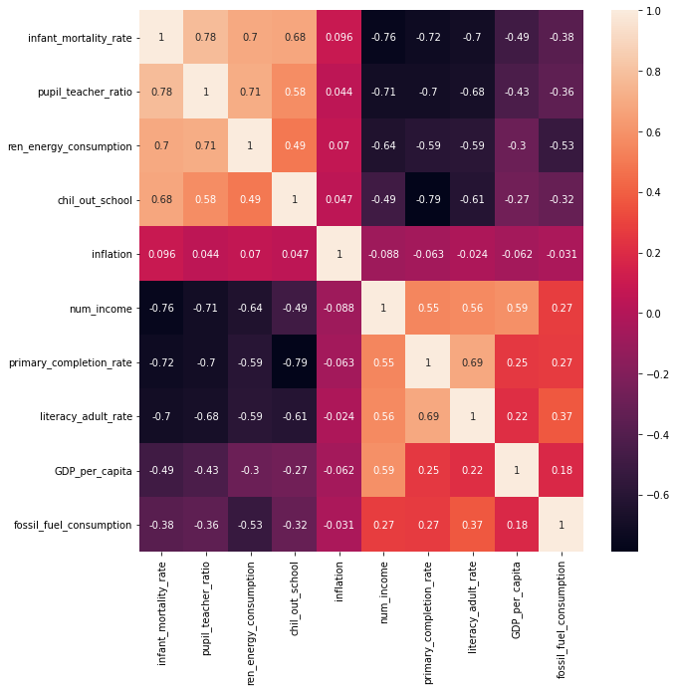
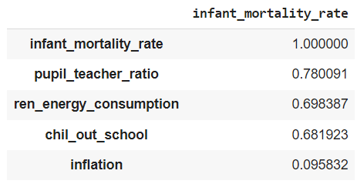
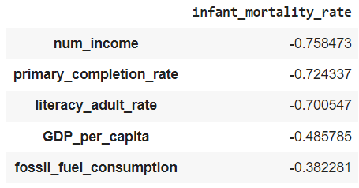
Is there any correlation?
Notes:
Graficar únicamente las de mayor correlación para que el gráfico se pueda entender

Slide 9

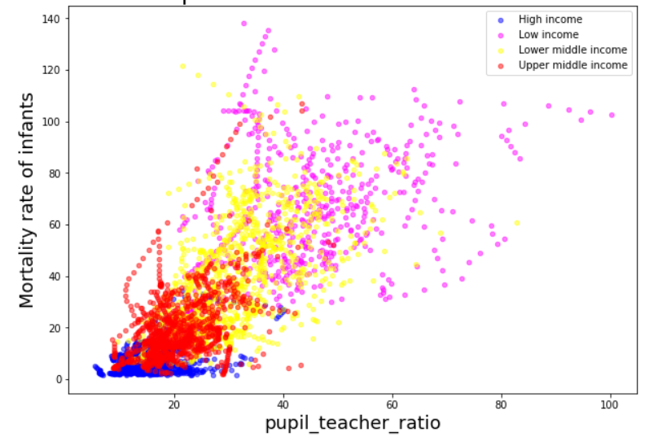

Relationship between pupil_teacher_ratio and infant mortality
There are a hundred students for every one teacher
There is low-quality teaching for students
Low-income countries
We should keep in mind that although there is a very strong correlation between education and infant mortality, it is necessary to determine if there is causality.

Slide 10
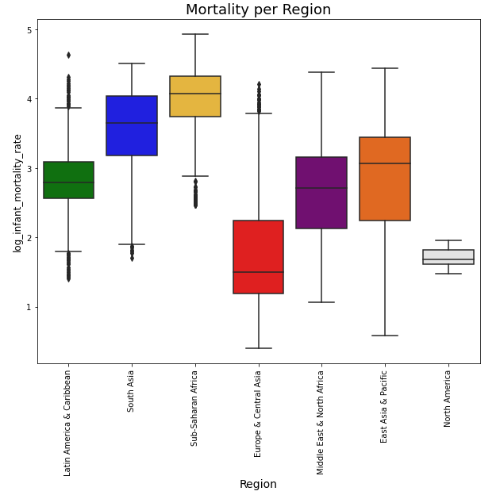
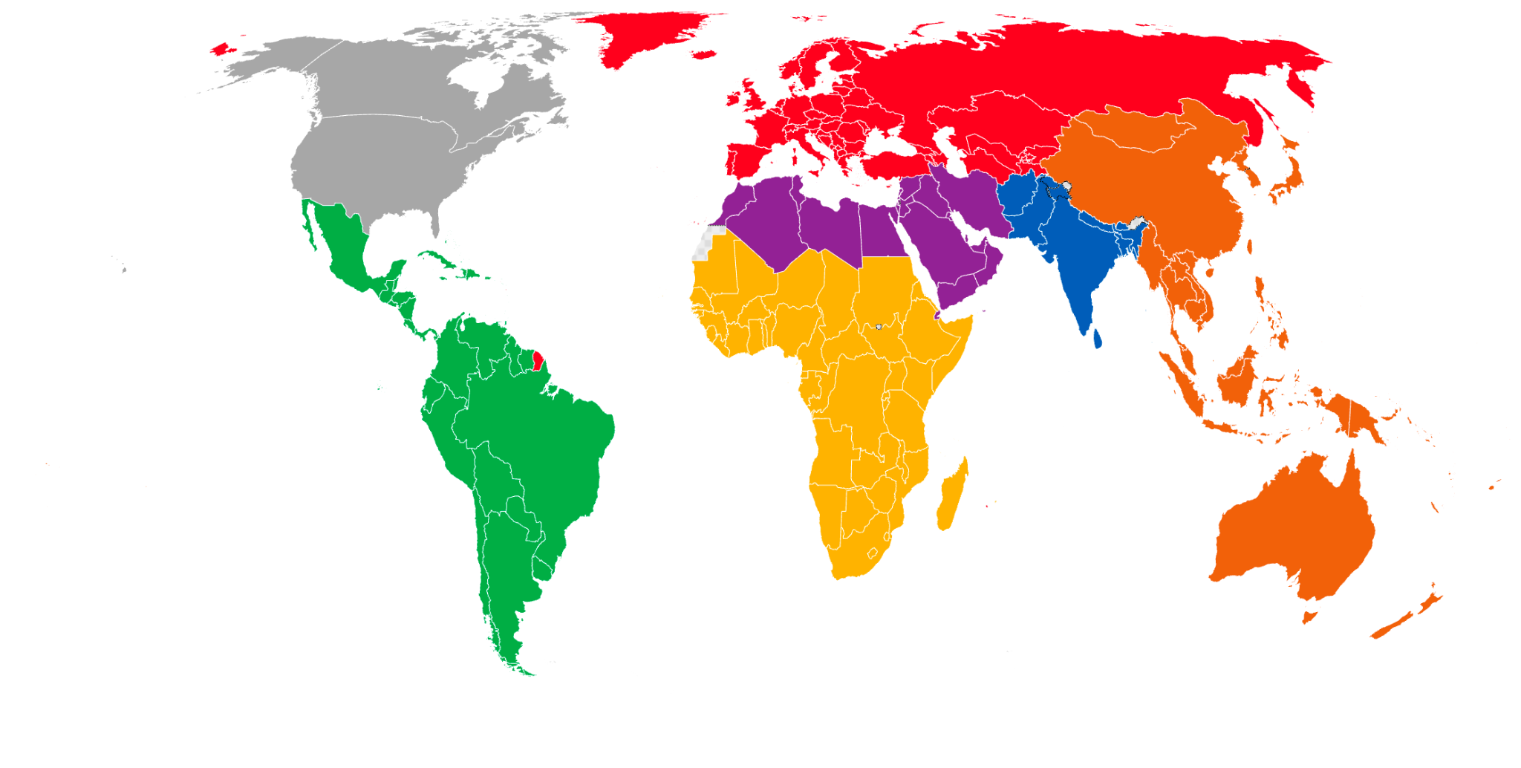
World Bank classification by regions

Slide 11
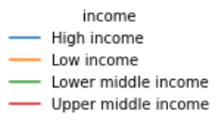
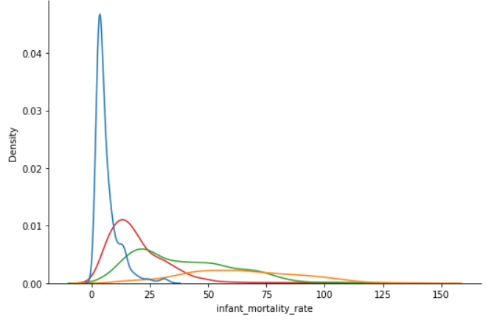

Does income have any influence on infant mortality?

Slide 12
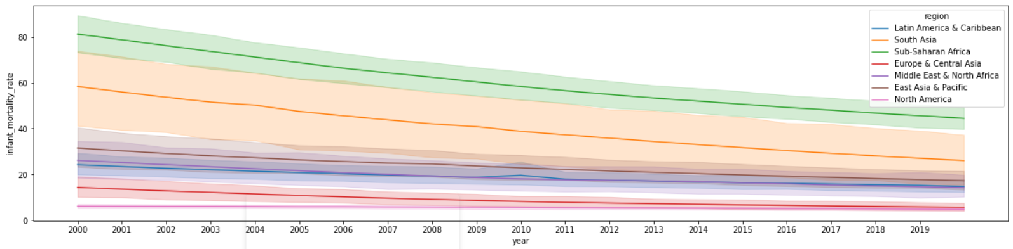
Historical infant mortality rate

Slide 13

Statistical Analysis and Model
Other variables and characteristics were added to the model.:
num_income, GDP_per_capita,
Infant_mortality_rate,
literacy_adult_rate
primary_completion_rate,
R- squared 0,72 increased
This is another variable combination to the model:
Infant_mortality_rate,
pupil_teacher_ratio
primary_completion_rate,
Ren_energy_consumption
Region
income
R- Squared: 0,757 better adjustment
We worked on linear regression in order to model the variable obtained by EDA which was higher.
pupil_ teacher_ratio con R-Squared 0.609

Slide 14

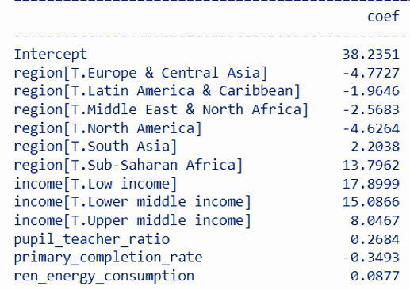
Final Model
Significative Variables
R-Squared: 0.757
Does it allow us to understand how the variables behave?
Does it permit us to verify the impact of education and economic growth on infant mortality?
The linear regression model with the variables of infant mortality rate vs. the regions + income presented an R2 of 0.695 and the p-values ​​of the Latin America & North America regions are greater than 0.05.
Notes:
Quitar el sumary y mostrar sólo las variables significativas

Slide 15
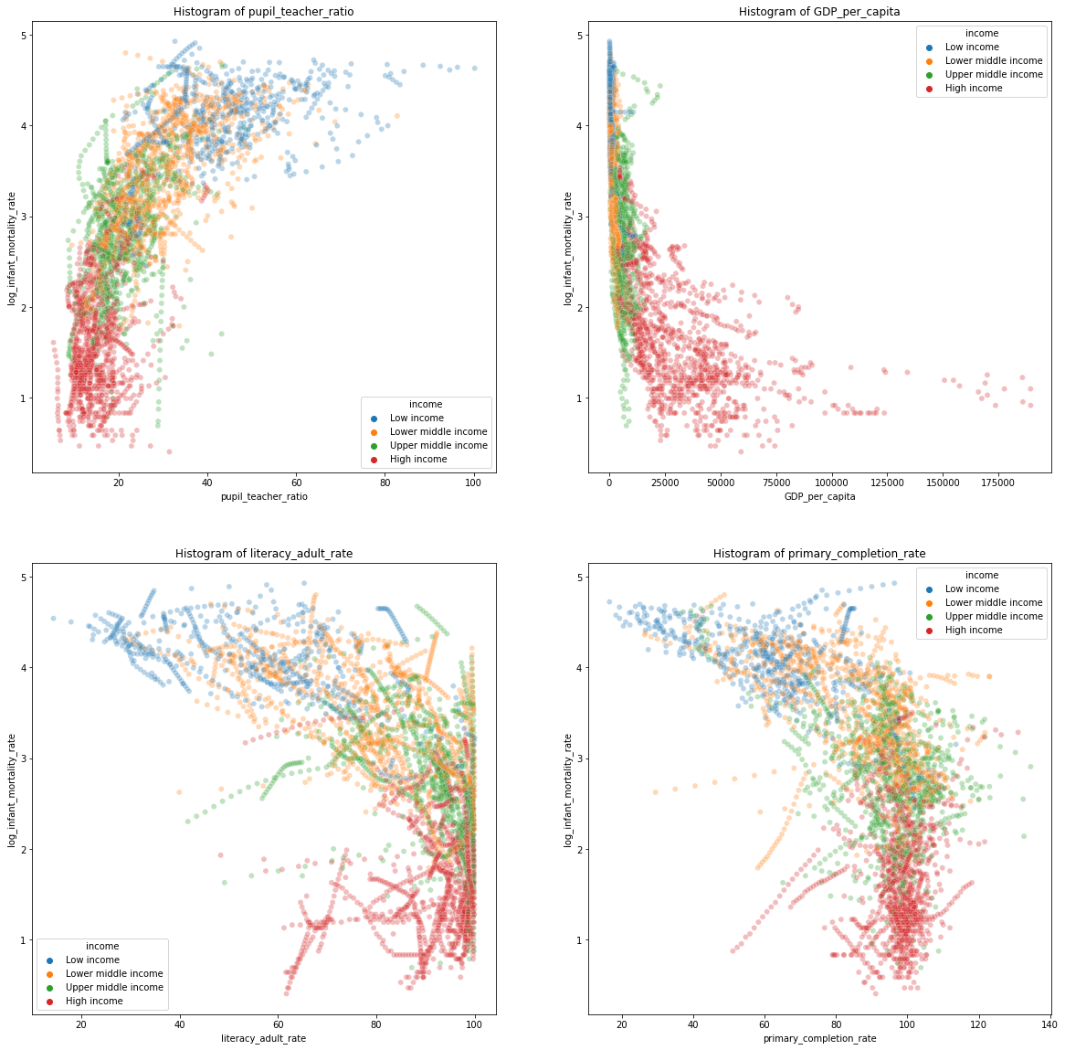
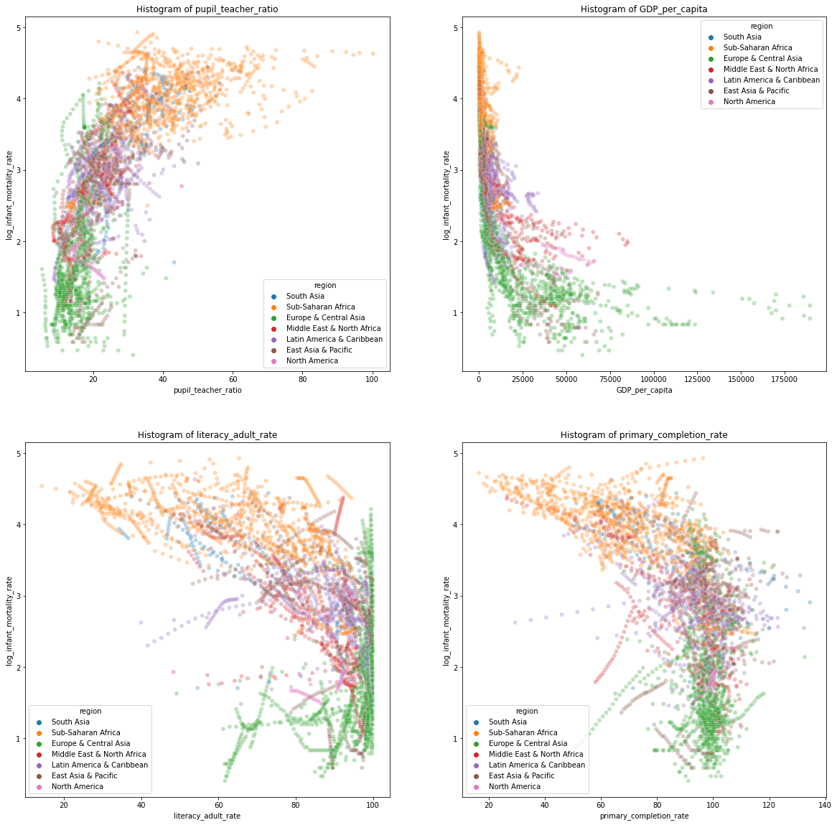
Variables with high correlations
Notes:
Las regiones y los ingresos se comportan indiferentemente en estas variables.

Slide 16
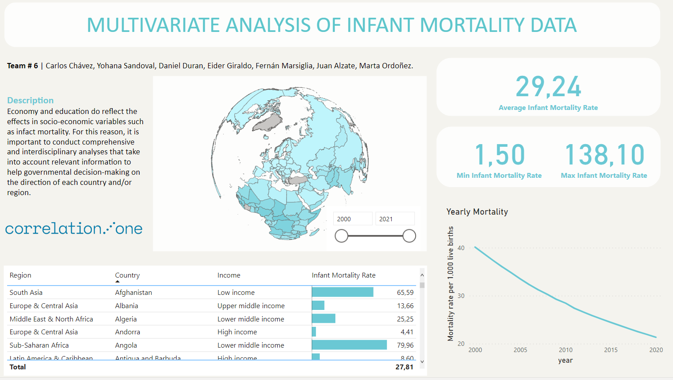

Slide 17
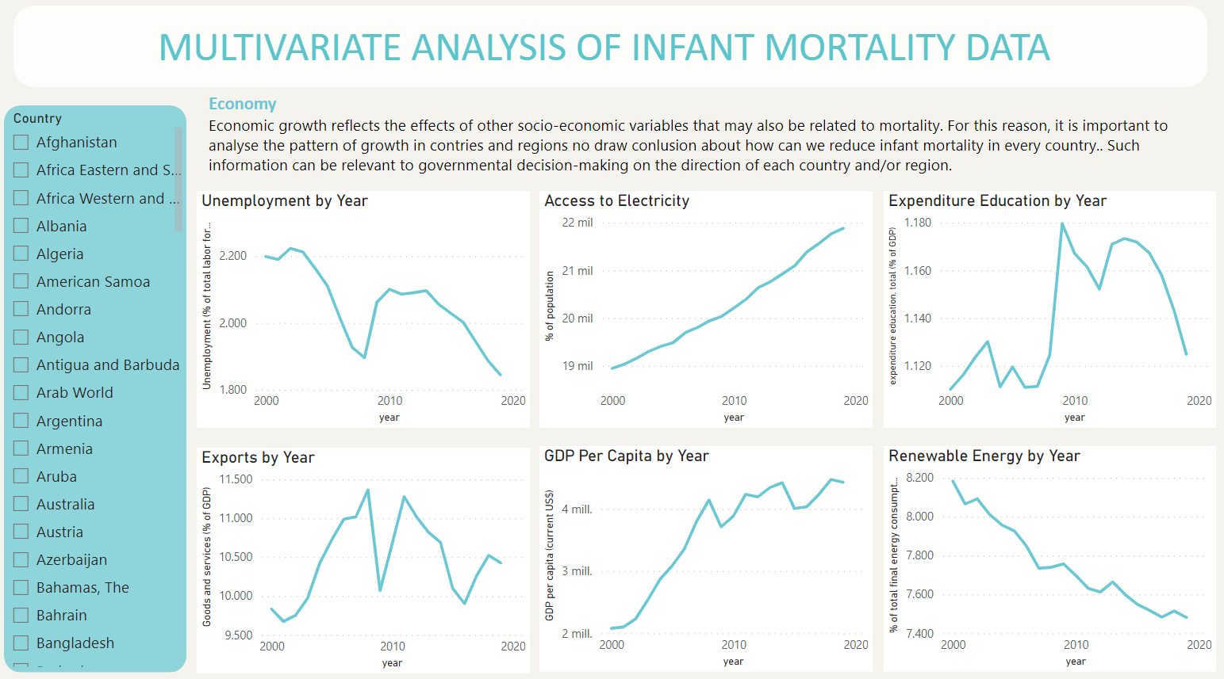

Slide 18
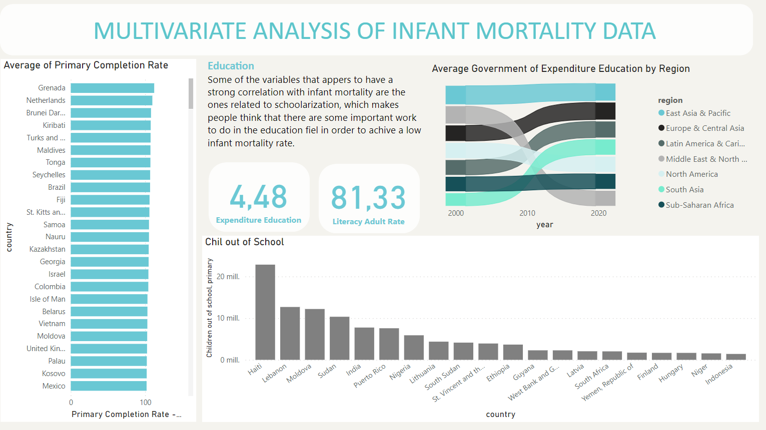

Slide 19



Conclusions
Recommendation
Some information might depend on the country and the year and is not totally independent as assumed in the linear model.
We propose to carry out a generalized linear mixed models (GLMMs)
Infant mortality is inversely proportional to the income level of the country or region. In turn, the countries or regions with the highest pupil-teacher ratio tend to reduce the cases of infant mortality.
Limitations
There are more variables that affect the study, so a more complete analysis would require much more information on the internal behavior of the states.
Further studies will be necessary.
Notes:
The linear regression models showed an increase in the adjustment as more variables were added to the calculation. We can also notice that after the initial mistake was corrected, we started to obtain results that were closer to what we initially expected, i.e., countries with more resources had less mortality rate than those with less economical power.
which seems to be more adequate for the data and the question that this project wanted to solve.
There is a variant of this model that considers hierarchies between the variables, where it can be said that the value measured (for example, schooling) depends on the country and the year and is not totally independent as assumed in the linear model.
Furthermore, it is shown that the linear model is a good approximation to understanding how the variables behave. It is also true that there may be other more complex models such as the supported vector machine or clustering models based on linear models that would give greater precision and accuracy, however these models tend to be poorly interpretable and not the best when performing a descriptive analysis. The latter would be more suitable for predictive rather than descriptive projects.
As we progress through the course we will implement more algorithms to better understand the relationships of our variables and see how they interact to answer our initial question.

Slide 20


TA: laura, Daniel, Esteban
Team # 6

